Slide 1
The relationship between temperature, humidity and human stress
PRINCIPLES AND APPLICATIONS OF DATA SCIENCE GROUP PROJECT PROPOSAL
Name: 顏翊純、黃彥文
Sid: 110599002、109598113
Date: 06/22/2022
National Taipei University of Technology
Computer Science and Information Engineering

Slide 2
OUTLINE
Introduction
Literature review and related works (文獻)
Problem statement
Proposed models (approaches)
Experiments
Conclusions
Others

Slide 3
INTRODUCTION
Motivation
Stress is an important issued today
How to help people to conscious stress
Objectives
Create a model which can predict the human stress by temperature and humidity
Application and Contributions
It’s important for people to find out if there is stress in their mind
These mental illnesses somehow caused by the nature environment
This tool can help people to predict the stress by temperature and humidity

Slide 4
LITERATURE REVIEW
“A Smart Sensor in the IoMT for Stress Level Detection”, 2018
L. Rachakonda, S. P. Mohanty, E. Kougianos, and P. Sundaravadivel collected the data from IoMT (Internet of Medical Things) devices.
These data classified the stress to three levels, and higher level means higher stress.
These data will be the input of the Deep Learning or Deep Neural Networks (DNN) models, and the output will be the stress level.
“Stress-Lysis: A DNN-integrated edge device for stress level detection in the IoMT”, 2019
Combines not only one data to do the prediction, quickly to detect stress level is presented and a novel IoMT-enabled system for stress analysis at the edge and not at the cloud is proposed, thus advancing the state-of-the-art in the IoMT.

Slide 5
LITERATURE REVIEW
For choosing the machine learning algorithms, especially SVM, we’ve searched for the using of different kernels, but at the end we still decide to do 4 kernels to have the comparison.
RBF is better to using on the non-linear data
linear SVC is different from the linear kernel, first one using the square to do the equation, last one using the absolute.

Slide 6
RELATED WORKS
There is someone on Kaggle use this data to do the prediction three months ago, after we decided to do this project one month later.
Their code is using Logistic Regression to do the experiment.
Logistic Regression is also a kind of classifier algorithms, which is used for predicting the categorical dependent variable using a given set of independent variables.
Algorithm | Accuarcy
Logistic Regression (On Kaggle) | 0.997506
K-NN (Our Project) | 0.9975
SVM Linear SVC (Our Project) | 0.9975
Decision Tree (Our Project) | 0.997506

Slide 7
PROBLEM STATEMENT
Scenario 1:
Rose is a university student who suffered by depression. It’s not easy for her to detect emotions herself. She hopes that if there is any tool can help her to find herself in the stressful way. By this way, she can release some of the stress earlier than accumulated pressure at the end and feel depress without doing anything.
Scenario 2:
Burt is a manger in the company, sometimes he felt that he’s easily get anger without any reason. By the stress predict, he can know that today will get a more stressful mood or more relax mood. It can help him to control the temper more easily.

Slide 8
PROPOSED MODELS (APPROACHES)
Linear analysis
We split data to 3 sets
60% as training data
20 % as verification data
20% as test data
Algorithm (classifier)
KNN
SVM
Decision Tree
Notes:
The data source classify stress to three level, 0, 1, 2, higher number means higher stress, so we choose classifier algorithms instead of regression algorithms.

Slide 9
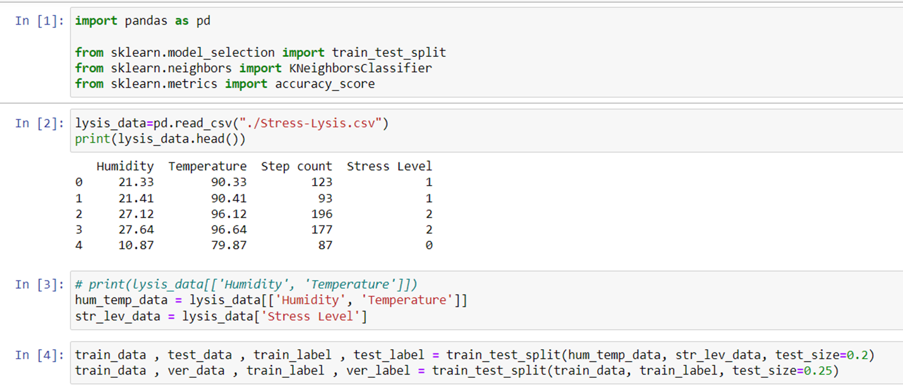
PROPOSED MODELS (APPROACHES)

Slide 10
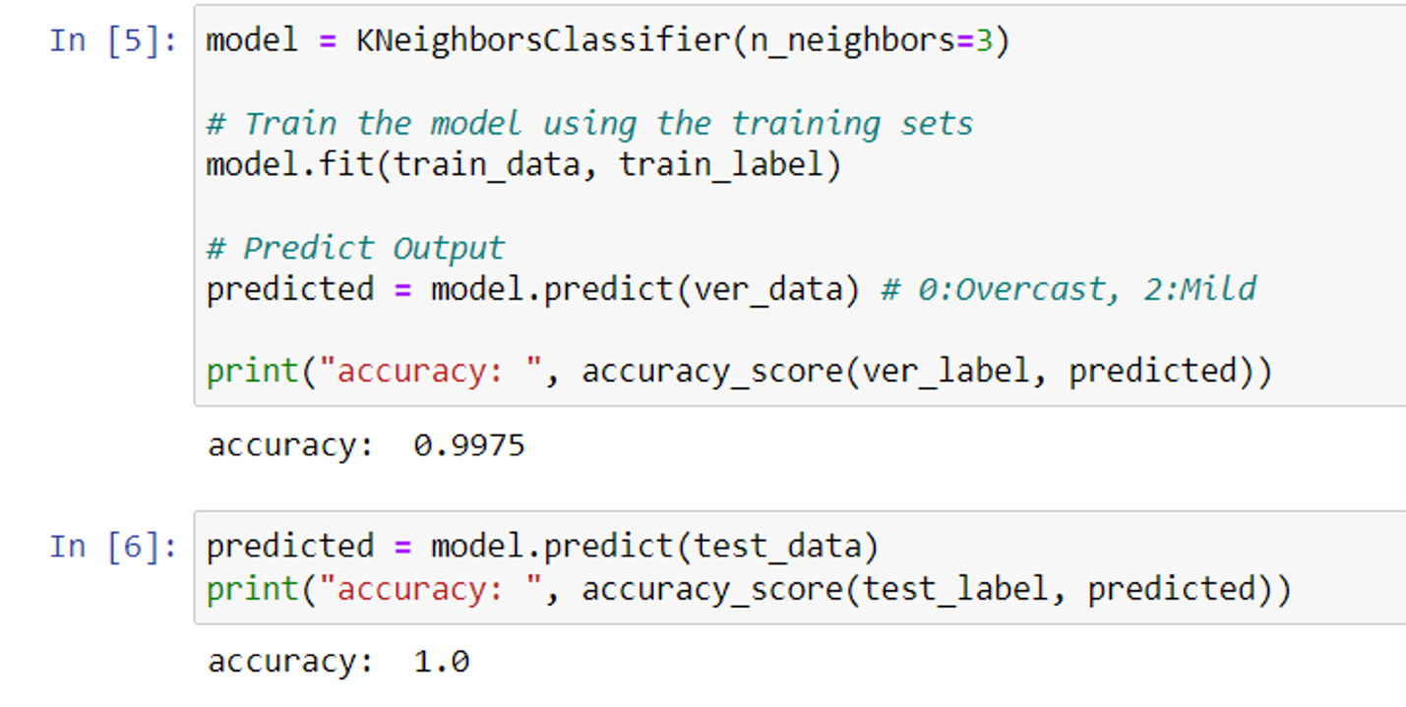
PROPOSED MODELS (APPROACHES)
KNN algorithm

Slide 11
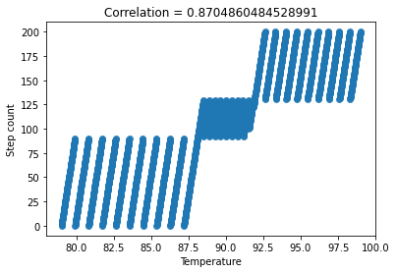
EXPERIMENTS
Linear analysis example:
Correlation coefficient between temperature and step count is 0.87

Slide 12
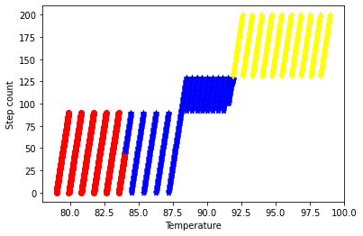
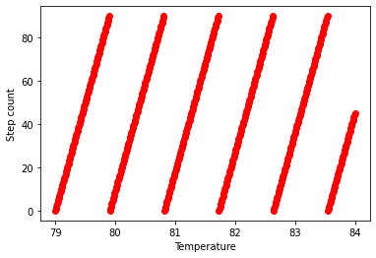
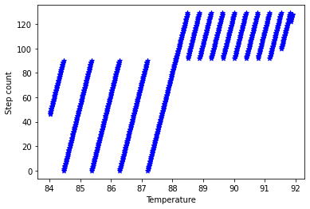
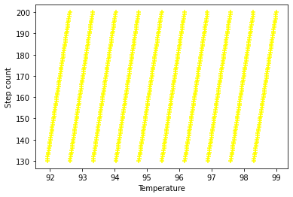
EXPERIMENTS
Linear analysis example:
Classify by Temperature and Step Count

Slide 13
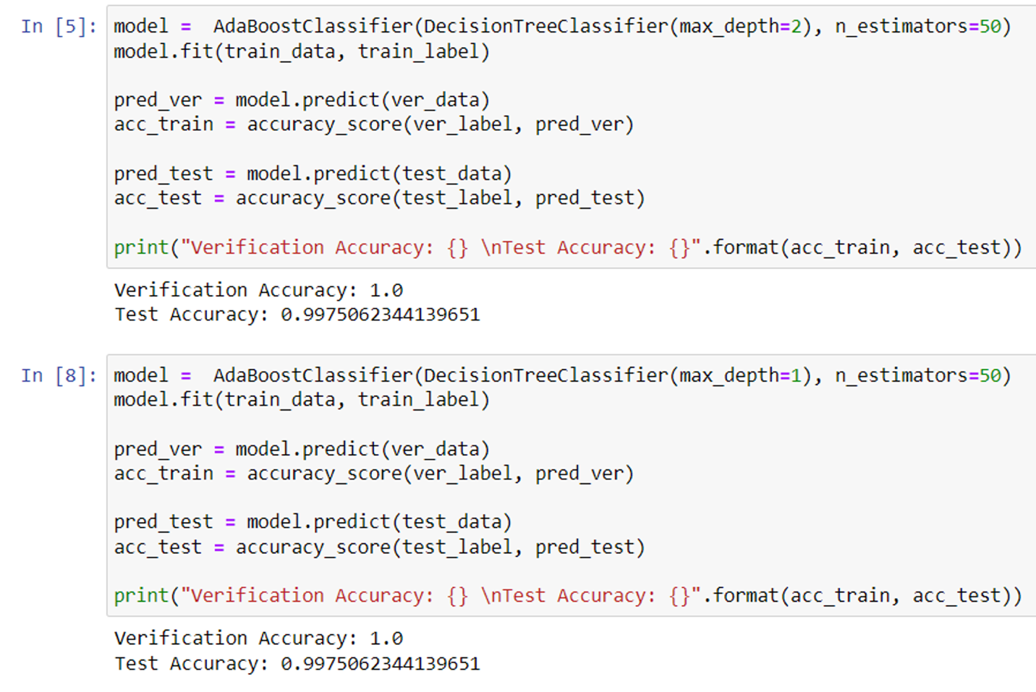
EXPERIMENTS
Algorithm: Decision Tree

Slide 14
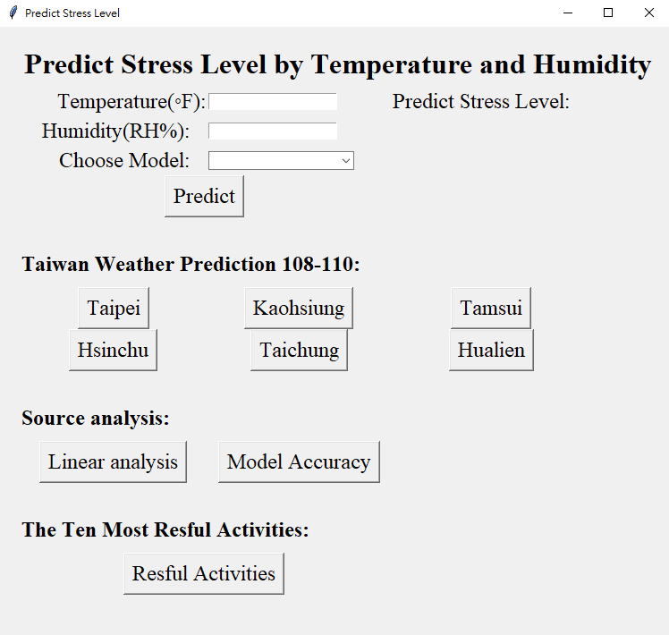
EXPERIMENTS
Window Application Stress Level Predict

Slide 15
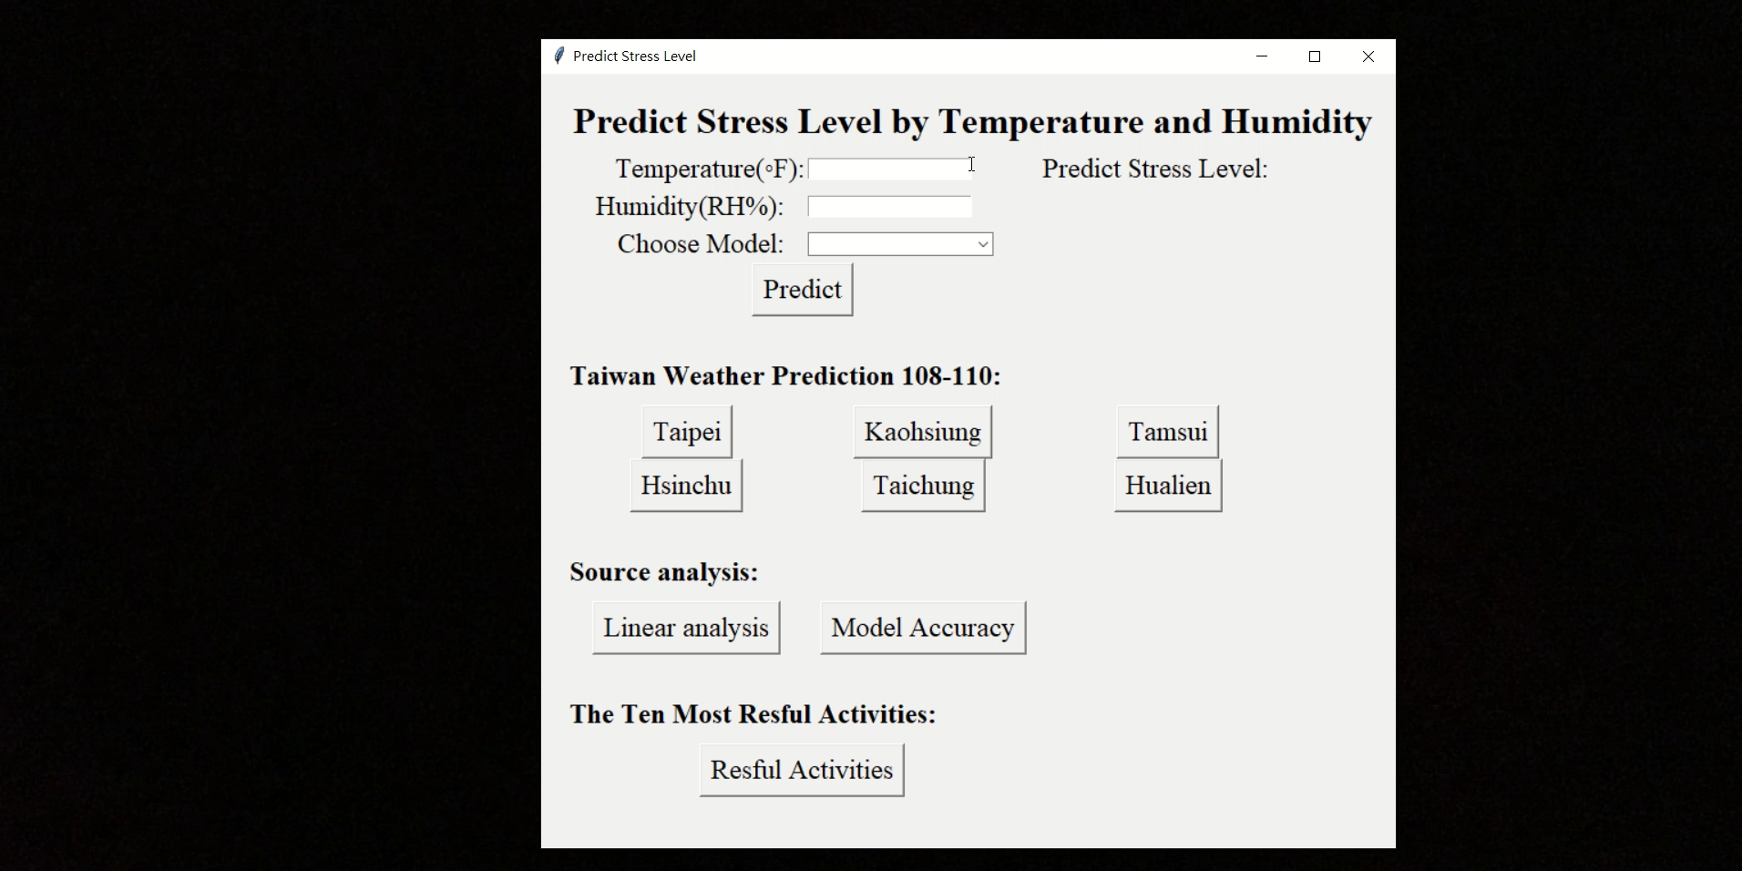
EXPERIMENTS
Window Application Stress Level Predict

Slide 16
EXPERIMENTS
Tools:
1. Jupyter notebook
Python Library: sklearn, pandas, tkinter
Data Sources:
“A Smart Sensor in the IoMT for Stress Level Detection” written by Rachakonda, L., Sundaravadivel, P., Mohanty, S. P., Kougianos, E., & Ganapathiraju, M.
“Stress-Lysis: A DNN-integrated edge device for stress level detection in the IoMT” written by Rachakonda, L., Mohanty, S. P., Kougianos, E., & Sundaravadivel, P.

Slide 17
CONCLUSIONS
We hope that predict model can help people conscious of their mental status.
We learned several algorithms which can train the model to classify the data.
User can compare the accuracy.
Using Taiwan’s data from year 108 to year 110 per month to do the prediction.
High humidity and high temperature will get higher stress level.
In the future
predicting model can combine other data to do the analysis
combine the IoT device to have warning message to user

Slide 18
TIMELINE
We use mobbing to discuss, develop and write documentations together, and the total time efforts are 162 hours(81 hours/person). Detailed records are as follows:
3/10
Discuss Project Plan
4/14
Midterm Report & Presentation Practice
4/20
Final Demo
3/17
3/27
4/02
4/07
Plots Data Directly & Analyze
Environment Setting
K-NN Practice
Midterm Report
Proposal Presentation
6/22
4/29
5/19, 5/27, 6/02, 6/08
6/9
6/10, 6/11, 6/12
6/16
Correlation Coefficient, SVM & Decision Tree
GUI
Discuss Final Report
Final Report
Presentation Practice
4/13
Read Papers
4/30
Refactor and Discuss Develop Plan

